Slide 1

School of Computing and Information Sciences Florida International University
Senior Project Introduction
Spring 2016
LegalWise 2.0
Product Owner
Team Members
Jaime Borras
Fernando Gomez
Yang Zhang
Instructor
Masoud Sadjadi
May 3rd, 2015
Notes:
Greet your audience, thank them for attending your presentation, introduce yourself, introduce your project, introduce your team members, and quickly indicate what each of you did in a high-level manner, and put more emphasis on your part/contribution.

Slide 2
Problem
The legal system uses a great amount of human labor to accomplish tedious tasks on formatted documents.
Legal documents are searched manually for case referrals and legal answers.
Ineffective
Inefficient
Expensive
Notes:
HERE: Introduce the problem that the whole project tackles
NEXT TO NEXT SLIDE: and stay focused on the parts that you have been working.
NEXT SILDE: Indicate if there is an existing previous system, enumerate its problems/limitations, etc.

Slide 3
Current System
LegalWise 1.0
Trained by wiki-based data.
Allows the user to:
- register
- log in
- search for general questions
Legal files were not indexed properly.
No support for legal questions.
Question and Answer system were outside of the project.
Notes:
HERE: Introduce the problem that the whole project tackles
NEXT TO NEXT SLIDE: and stay focused on the parts that you have been working.
NEXT SILDE: Indicate if there is an existing previous system, enumerate its problems/limitations, etc.

Slide 4
What is LegalWise 2.0?
LegalWise 2.0
LegalWise 2.0 is a web application that can facilitate legal professionals to answer legal questions as well as locate the case referrals using artificial intelligence technologies. This application helps to save a great amount of time by supporting legal answers with ranking and case referrals electronically.
Notes:
HERE: Introduce the problem that the whole project tackles
NEXT TO NEXT SLIDE: and stay focused on the parts that you have been working.
NEXT SILDE: Indicate if there is an existing previous system, enumerate its problems/limitations, etc.

Slide 5
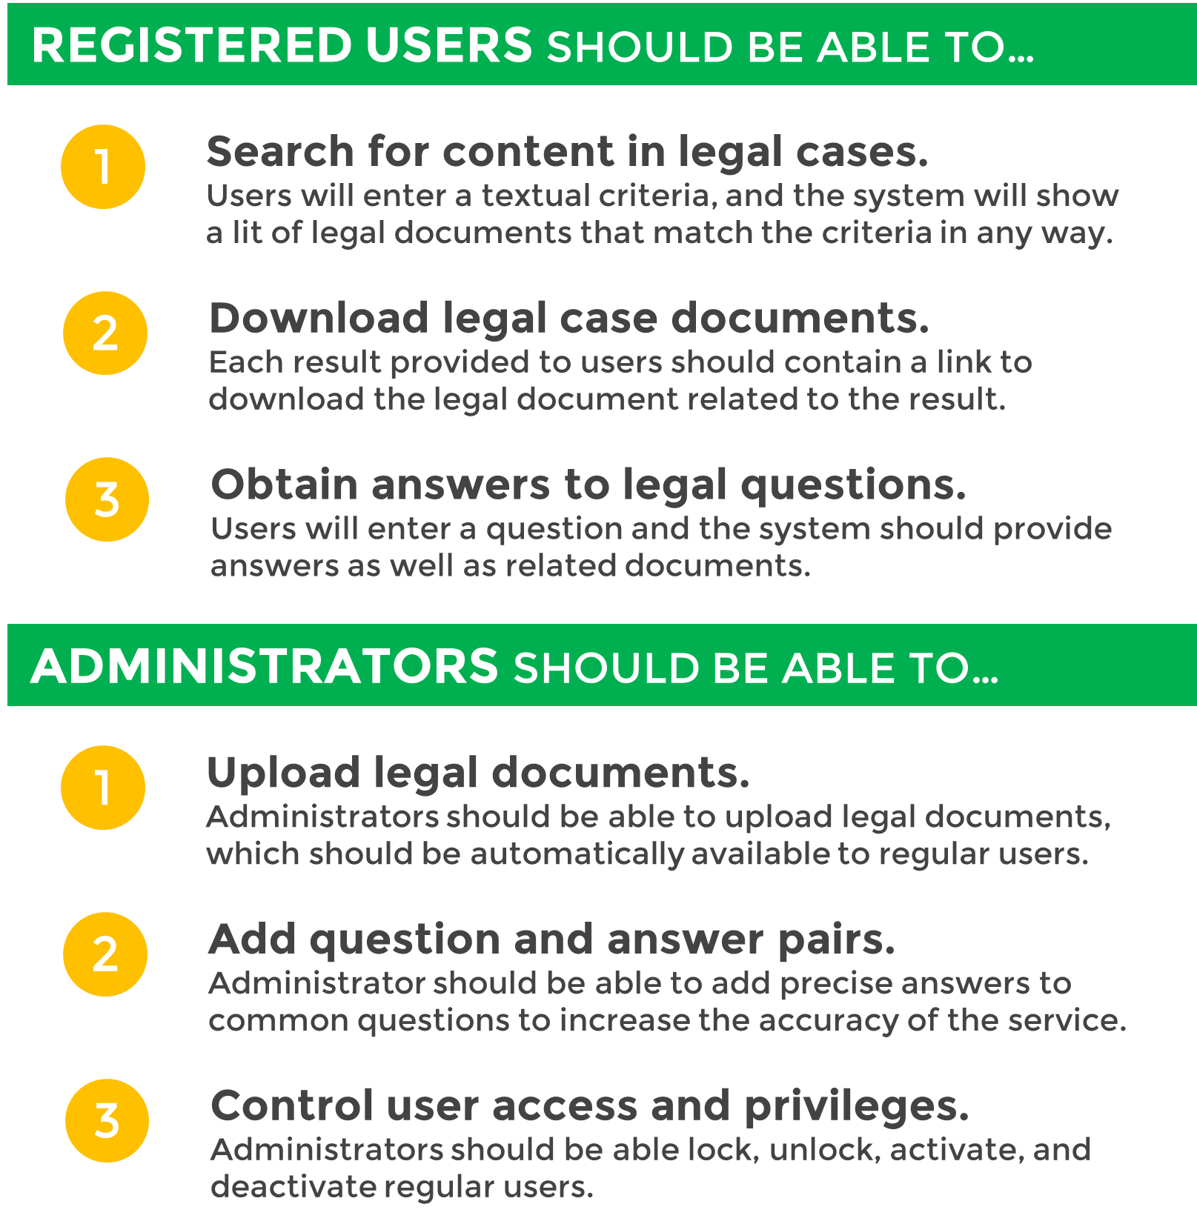
Requirements
Notes:
HERE: Introduce the problem that the whole project tackles
NEXT TO NEXT SLIDE: and stay focused on the parts that you have been working.
NEXT SILDE: Indicate if there is an existing previous system, enumerate its problems/limitations, etc.

Slide 6
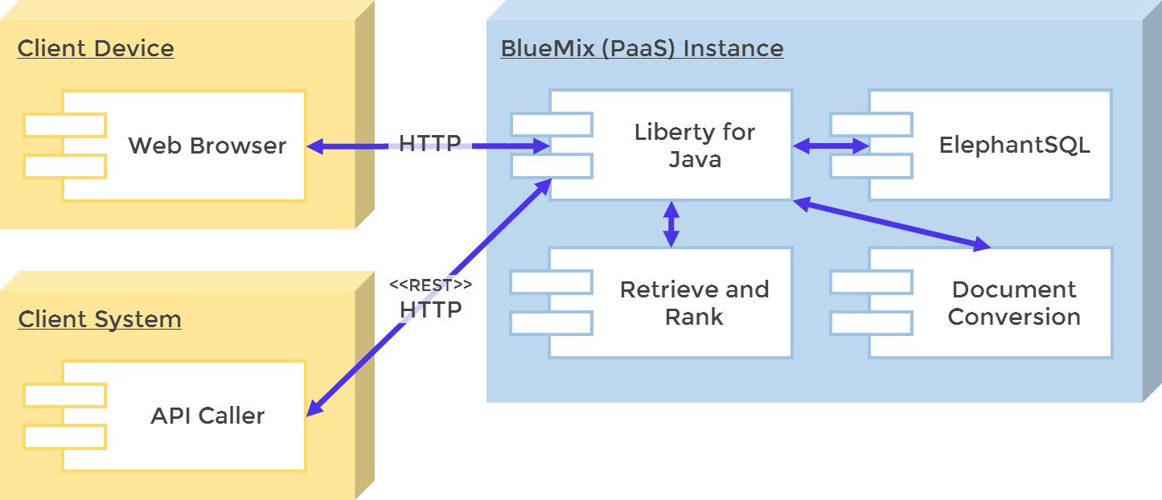
System Design
SYSTEM DEPLOYMENT
Notes:
5. System design:
5.1. System decomposition; identify the architecture patterns used (one slide).
5.2. System deployment – h/w and s/w requirements (one slide).
5.3. Persistent data design (one slide).
5.4. Security/Privacy (one slide).

Slide 7
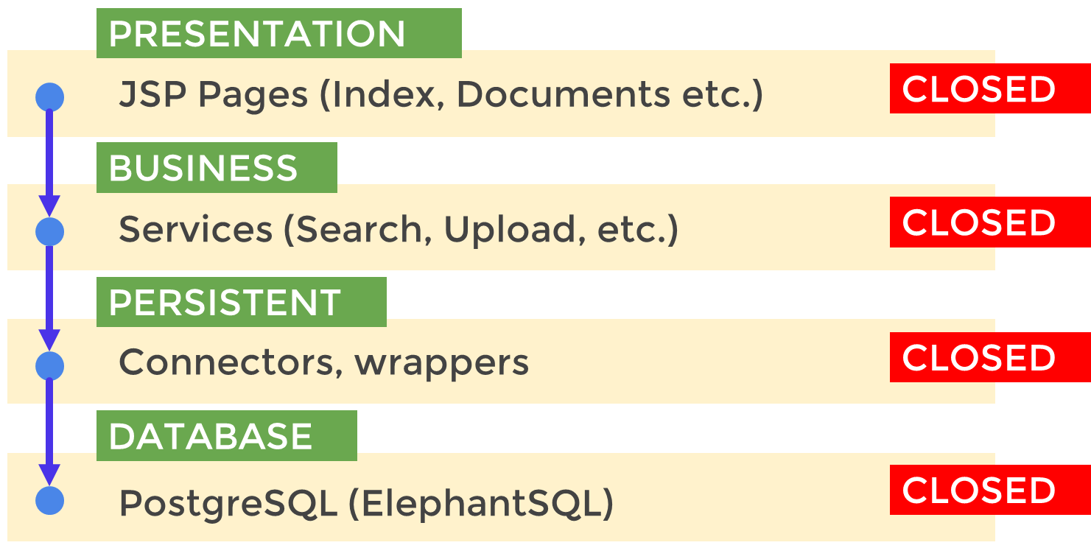
System Architecture
4-LAYERED ARCHITECTURE PATTERN
Notes:
5. System design:
5.1. System decomposition; identify the architecture patterns used (one slide).
5.2. System deployment – h/w and s/w requirements (one slide).
5.3. Persistent data design (one slide).
5.4. Security/Privacy (one slide).

Slide 8
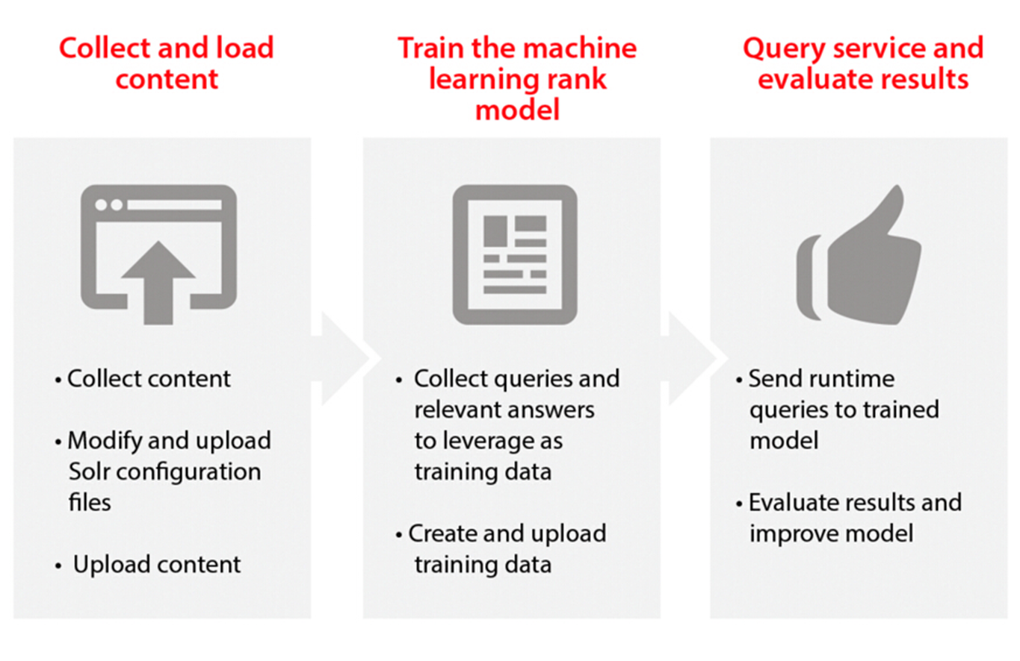
How does the artificial intelligence component work?
Watson Retrieve and Rank
Notes:
5. System design:
5.1. System decomposition; identify the architecture patterns used (one slide).
5.2. System deployment – h/w and s/w requirements (one slide).
5.3. Persistent data design (one slide).
5.4. Security/Privacy (one slide).

Slide 9
Sequence Diagram
Ask a legal question
Notes:
4. Requirements:
4.1. User stories implemented (one or more slides).
4.2. UML use cases and the use case diagram for the implemented use cases (one or more slides).
4.3. UML sequence diagrams for the implemented use cases.

Slide 10
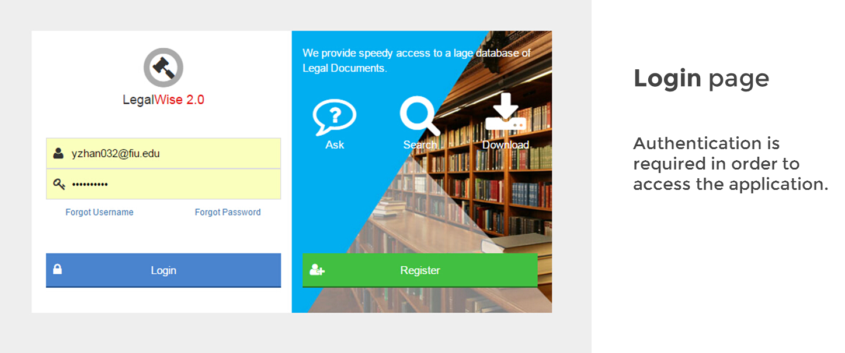
User Interface Design
Login Page
Notes:
4. Requirements:
4.1. User stories implemented (one or more slides).
4.2. UML use cases and the use case diagram for the implemented use cases (one or more slides).
4.3. UML sequence diagrams for the implemented use cases.

Slide 11
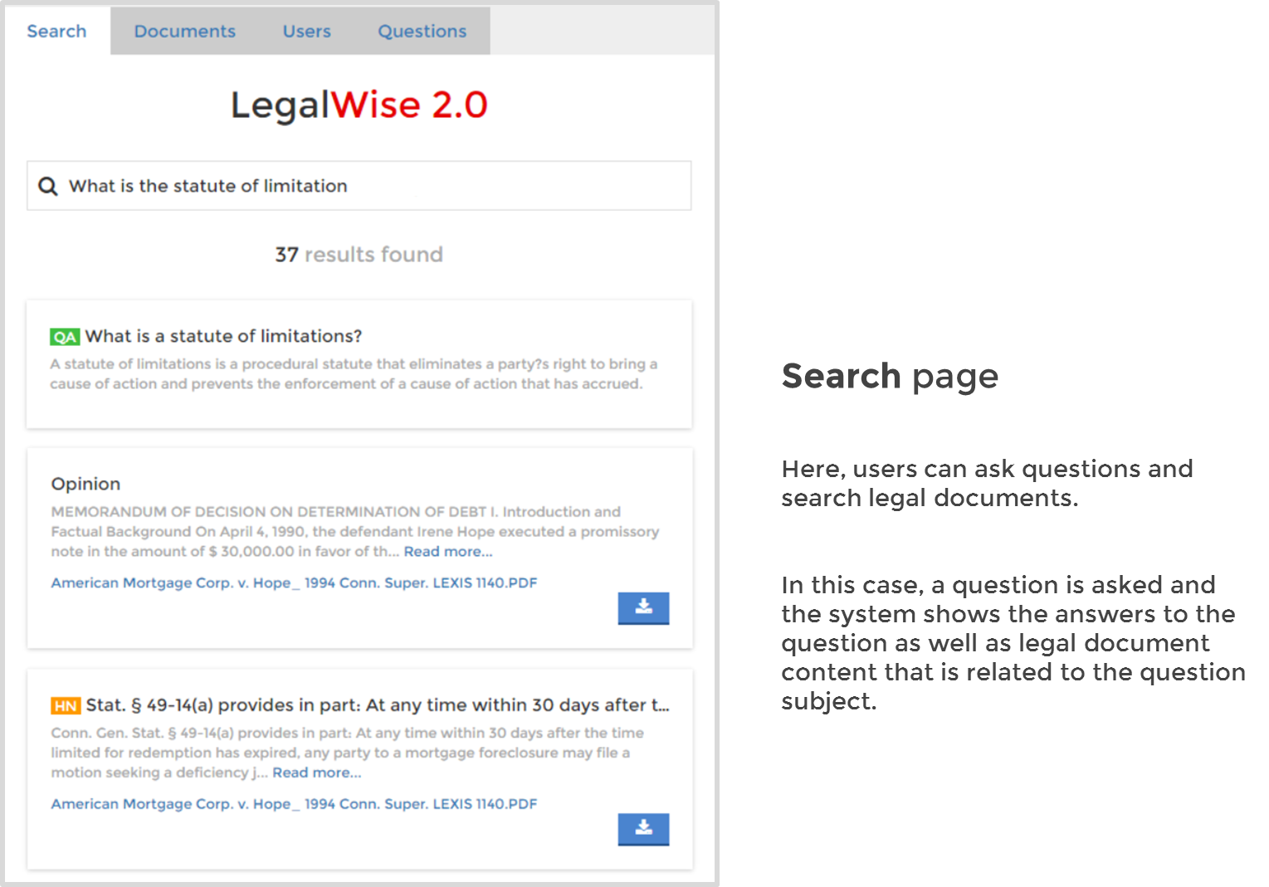
User Interface Design
Search Page
Notes:
4. Requirements:
4.1. User stories implemented (one or more slides).
4.2. UML use cases and the use case diagram for the implemented use cases (one or more slides).
4.3. UML sequence diagrams for the implemented use cases.

Slide 12
Summary
LegalWise 2.0 is a user-friendly web application that answers legal questions using artificial intelligence technologies. It solved all the shortcomings left from LegalWise 1.0. What is more, it does not only “search” the legal question, but also “answer” the legal question. It also provides an automated process to upload and index legal documents, which will then be shared with law professionals based on the content of these documents.
Our web application allows the registered users to search and retrieve answers in just a few seconds, which makes the valuable time of our legal professionals more profitable.
Notes:
Summarize your contribution
Include your contact information
Ask if anyone has any questions for you.
Thank your audience

Slide 13

THANK YOU!!!
LegalWise 2.0
Notes:
Summarize your contribution
Include your contact information
Ask if anyone has any questions for you.
Thank your audience

